Slide 1
THE SCIENCE OF SIN AND SALVATION
ROBERT MELASHENKO MD
Copyright Robert Melashenko 2013
All Rights Reserved

Slide 2
Lecture 7
THE TEN COMMANDMENTMENTS

Slide 3
REVIEW
Eve was “deceived” into eating the fruit because she desired the “upgrade” to her information system. (to make wise)
The temptation was a premeditated, masterfully executed attack designed to disarm her defenses and appeal to her intellect.

Slide 4
She was not tempted to believe in a different God, make an idol, tell an untruth, or even covet something….because none of these would have tempted her in the slightest! Why? Because she did not have the circuitry that connect those “behaviors” to her “reward center.” (nucleus acumens)

Slide 5
The “upgrade” that Eve thought she was getting was the start of a catastrophic functional and structural change to her genome, resulting in the addition and loss of brain circuitry, among other things.
These changes resulted in a predisposition to “behaviors” she would never have imagined before -- much less acted out.
These “behaviors” are identified in the Ten Commandments.

Slide 6
Why then serves the law? It was added because of transgressions, till the seed should come to whom the promise was made; and it was ordained by angels in the hand of a mediator.
(Galatians 3:19 AKJV)
What shall we say then? Is the law sin? God forbid. No, I had not known sin, but by the law: for I had not known lust, except the law had said, You shall not covet. (Romans 7:7 AKJV)

Slide 7
TEN COMMANDMENTS = DIAGNOSIS CHART

Slide 8
In this talk, we will examine Commandments 4 and 7
These commandments have been the particular targets of the adversary.
Why?
Hint: Think Information Theory!

Slide 9
You shall not commit adultery.
(Exodus 20:14 AKJV)

Slide 10
Whoever puts away his wife, and marries another, commits adultery: and whoever marries her that is put away from her husband commits adultery.
(Luke 16:18 AKJV)

Slide 11
But wait a minute…..hadn’t God told Moses that divorce was okay?
When a man has taken a wife, and married her, and it come to pass that she find no favor in his eyes, because he has found some uncleanness in her: then let him write her a bill of divorce, and give it in her hand, and send her out of his house. And when she is departed out of his house, she may go and be another man's wife. (Deuteronomy 24:1-2 AKJV)
Is God contradicting himself?

Slide 12
At this point in the discussion, we need to stop and find out more about marriage, sex, and how they relate to adultery.

Slide 13
Does “adultery” only apply to married people?
In Leviticus 18, Moses expands on the definition to include:
Sex with a blood relative. (kin)
Sex with your wife’s sister, or her daughter, the daughter of your wife and another man, your daughter-in-law, and your neighbor’s wife—no “kin” genetic relationship; marriage not an issue.
Bestiality.
Same sex union.
Sex with a women who is menstruating.

Slide 14
Customs of the Time
After the doings of the land of Egypt, wherein ye dwelt, shall ye not do: and after the doings of the land of Canaan, whither I bring you, shall ye not do: neither shall ye walk in their ordinances.
(Lev 18:3)

Slide 15
For it seemed good to the Holy Ghost, and to us, to lay on you no greater burden than these necessary things; That you abstain from meats offered to idols, and from blood, and from things strangled, and from fornication (porneia): from which if you keep yourselves, you shall do well. Fare you well.
(Acts 15:28-29 AKJV)

Slide 16
Therefore, the definitions in both the Old and New Testament are the same.
πορνεία
porneia
Thayer Definition:
1) illicit sexual intercourse
1a) adultery, fornication, homosexuality, lesbianism, intercourse with animals etc.
1b) sexual intercourse with close relatives; Lev. 18
1c) sexual intercourse with a divorced man or woman;

Slide 17
Moses Raises the Bar on Adultery.
When a man has taken a wife, and married her, and it come to pass that she find no favor in his eyes, because he has found some uncleanness in her: then let him write her a bill of divorce, and give it in her hand, and send her out of his house. And when she is departed out of his house, she may go and be another man's wife. And if the latter husband hate her, and write her a bill of divorce, and gives it in her hand, and sends her out of his house; or if the latter husband die, which took her to be his wife; Her former husband, which sent her away, may not take her again to be his wife, after that she is defiled; for that is abomination before the LORD: and you shall not cause the land to sin, which the LORD your God gives you for an inheritance.
(Deuteronomy 24:1-4 AKJV)

Slide 18
Christ raises the bar on adultery……higher!
Why they are no more two, but one flesh. What therefore God has joined together, let not man put asunder. They say to him, Why did Moses then command to give a writing of divorce, and to put her away? He said to them, Moses because of the hardness of your hearts suffered you to put away your wives: but from the beginning it was not so. And I say to you, Whoever shall put away his wife, except it be for fornication, and shall marry another, commits adultery: and whoever marries her which is put away does commit adultery.
(Matthew 19:6-9 AKJV)

Slide 19
And Even Higher…
But I say to you, That whoever looks on a woman to lust after her has committed adultery with her already in his heart.
(Matthew 5:28 AKJV)

Slide 20
In a perfect environment like Eden, all humanity would have been extremely good looking, had perfect bodies, been very witty and intelligent, and wanting for nothing in material goods. Forever is a very, very long time…….anything that can happen will happen under this scenario. How could God expect a union between a man and a women to last forever under these conditions? Today, with almost none of the attributes just mentioned, over 50% of marriages do not last—most breaking up within 5 years.

Slide 21
How could God expect Adam and Eve (and their children) to ever live up to these requirements?

Slide 22
And the rib, which the LORD God had taken from man, made he a woman, and brought her to the man. And Adam said, This is now bone of my bones, and flesh of my flesh: she shall be called Woman, because she was taken out of Man. Therefore shall a man leave his father and his mother, and shall join (to be joined together)to his wife: and they shall be one flesh (body). (Genesis 2:22-24 AKJV)
This passage infers that the man and woman would be so closely merged together that they would become one -- together forever -- just as the rib from Adam would be a permanent part of Eve for as long as she lived.

Slide 23
Christ retells the story this way:
And he answered and said to them, Have you not read, that he which made them at the beginning made them male and female, And said, For this cause shall a man leave father and mother, and shall join to his wife: and they two shall be one flesh? Why they are no more two, but one flesh. What therefore God has joined together, let not man put asunder.
(Matthew 19:4-6 AKJV)
The phrase “one flesh” connotes an actual physical bonding…..could this be the answer?

Slide 24
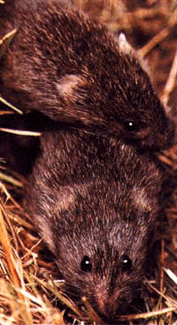
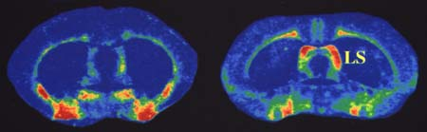
The loves of voles
Vasopressin receptors in the brain
Prairie vole
Montane vole
Married bliss
in prairie voles
Insel, T. and Young, L. 2001. Nature reviews Neuroscience 2:129-136

Slide 25
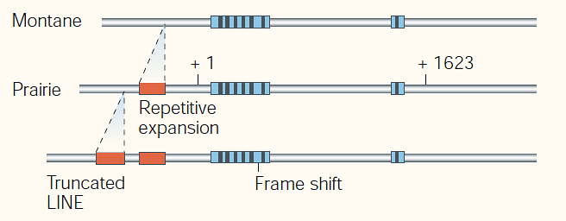
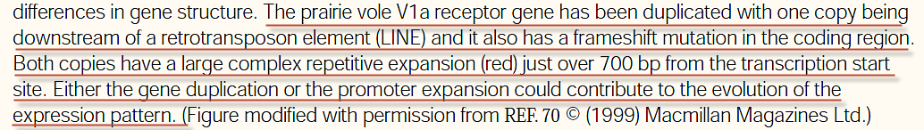
NATURE REVIEWS | NEUROSCIENCE VOLUME 2 | FEBRUARY 2001

Slide 26
Engineered monogamy
Prairie vole vasopressin receptor
gene
Meadow vole
Promiscuous
Monogamous

Slide 27
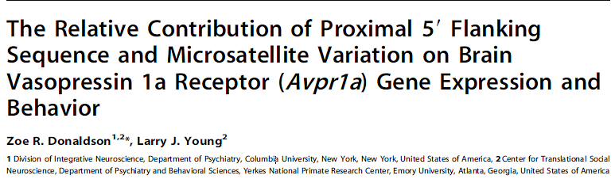
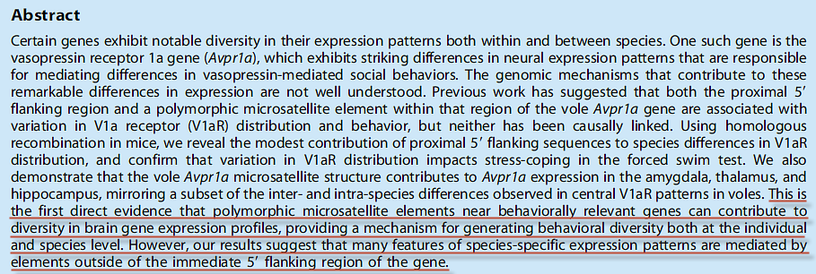
PLOS Genetics | 1 August 2013 | Volume 9 | Issue 8

Slide 28
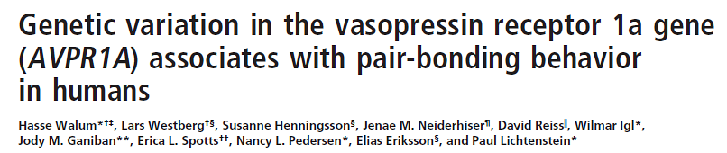
PNAS September 16, 2008 vol. 105 no. 37 14153–14156

Slide 29
Spouses are chemically “addicted” to each other, with the “addiction” continuing to strengthen over time.

Slide 30
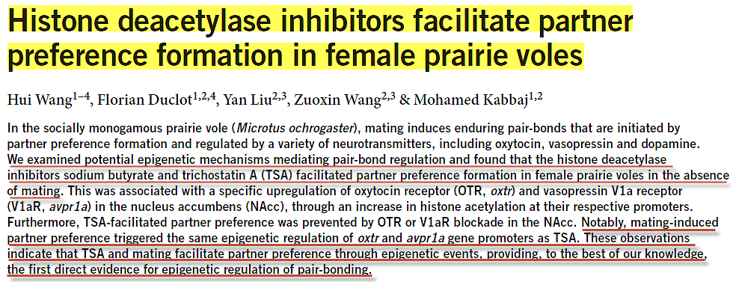
2 June 2013 - Nature Neuroscience

Slide 31
Could this be what Christ was referring to in the following passage?
But I say to you, That whoever looks on a woman to lust after her has committed adultery with her already in his heart.
(Matthew 5:28 AKJV)

Slide 32

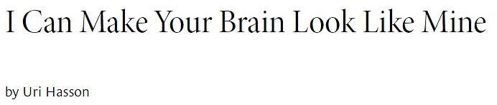
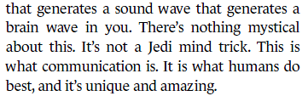
HARVARD BUSINESS REVIEW. DEC 2010

Slide 33
Does chemically changing the circuits in the brain qualify as making “one flesh” (body)?
microRNA’s

Slide 34
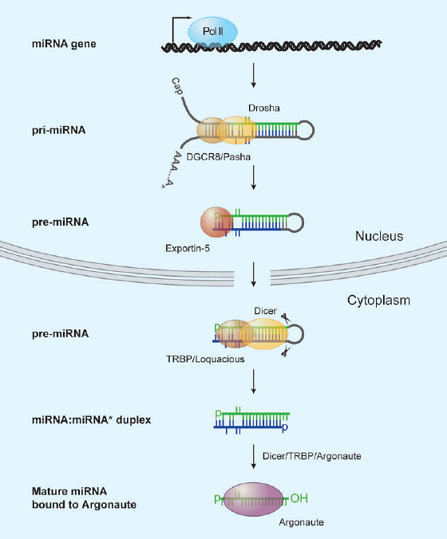
Annu. Rev. Cell Dev. Biol. 2007. 23:175–205

Slide 35
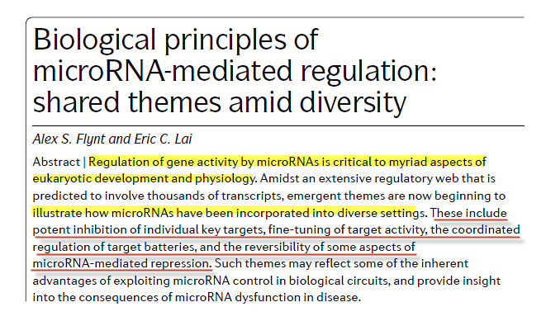
miRNAs as reversible regulators
NATURE REVIEWS | genetics Vol. 9 | Nov. 2008 | 831

Slide 36
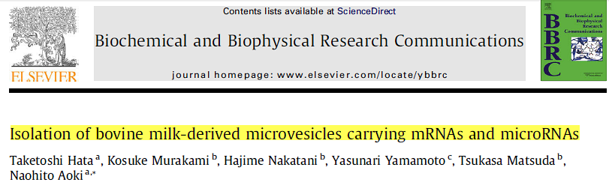
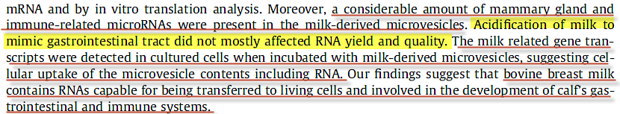
Biochemical and Biophysical Research Communications 396 (2010) 528–533

Slide 37
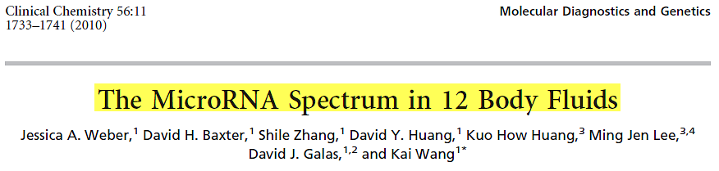
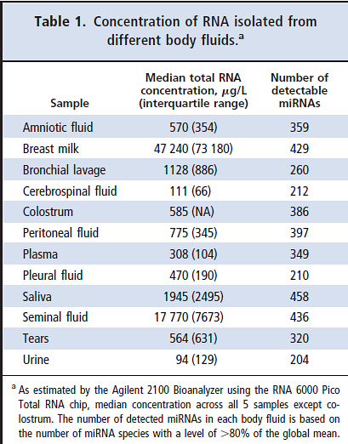

Slide 38
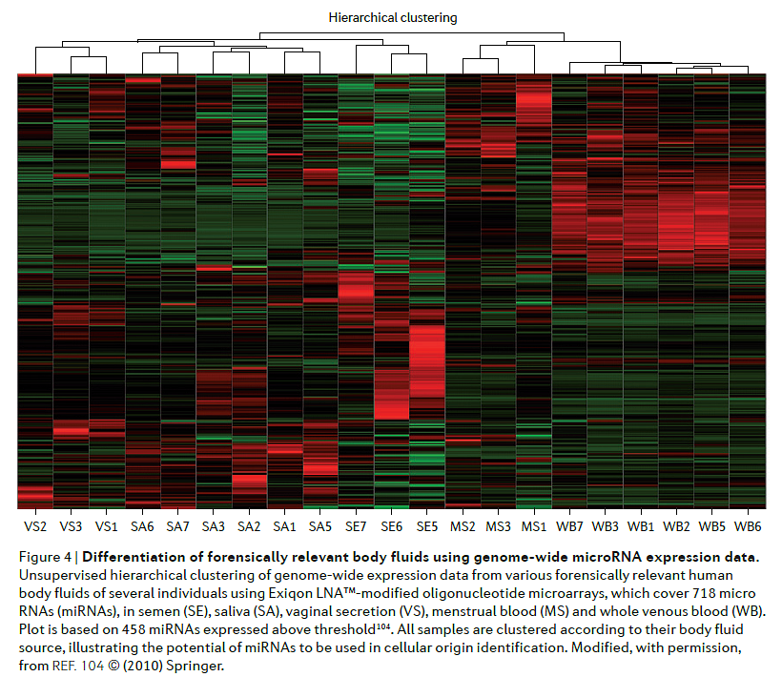
NATURE REVIEWS | GENETICS VOLUME 12 | MARCH 2011

Slide 39
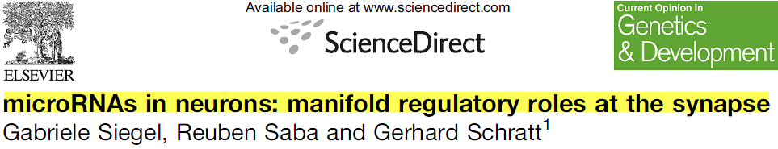
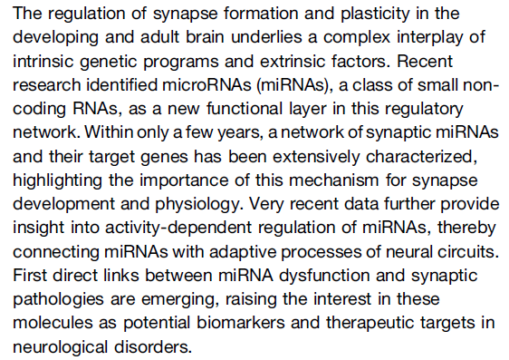
Current Opinion in Genetics & Development 2011, 21:1–7

Slide 40
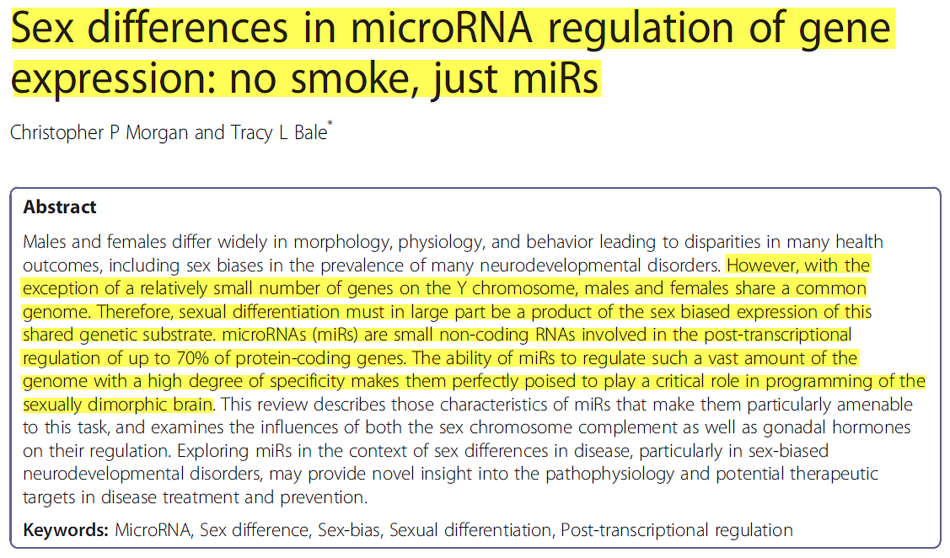
Morgan and Bale- Biology of Sex Differences 2012, 3:22

Slide 41
microRNA exchange = “one flesh”?
Yes!

Slide 42
Know you not that your bodies are the members of Christ? shall I then take the members of Christ, and make them the members of an harlot? God forbid.
What? know you not that he which is joined to an harlot is one body? for two, said he, shall be one flesh.
But he that is joined to the Lord is one spirit.
Flee fornication. Every sin that a man does is without the body; but he that commits fornication sins against his own body.
What? know you not that your body is the temple of the Holy Ghost which is in you, which you have of God, and you are not your own?
For you are bought with a price: therefore glorify God in your body, and in your spirit, which are God's.
(1 Corinthians 6:15-20 AKJV)

Slide 43
Why The Seventh Commandment?
Sex with a relative. (genetic mutations and miRNA’s)
Sex with sister-in-law/her daughter, step-daughter, daughter-in-law, neighbor’s wife—no close genetic relationship, marriage not an issue (miRNA’s)
Bestiality. (miRNA’s)
Same-sex (miRNA’s)
Sex with menstruating women . (miRNA’s and STD)

Slide 44
Information Theory and the Seventh Commandment
Children
One Flesh
Physical Intimacy
Mental Intimacy
Friendship
Acquaintance

Slide 45
Can two walk together, except they be agreed?
(Amos 3:3 AKJV)
Be you not unequally yoked together with unbelievers: for what fellowship has righteousness with unrighteousness? and what communion has light with darkness?
And what concord has Christ with Belial? or what part has he that believes with an infidel?
And what agreement has the temple of God with idols? for you are the temple of the living God; as God has said, I will dwell in them, and walk in them; and I will be their God, and they shall be my people.
(2 Cor. 6:14-16 AKJV)

Slide 46
“Information” exchange the basis for our relationship with God?
For I am jealous over you with godly jealousy: for I have espoused you to one husband, that I may present you as a chaste virgin to Christ. (2 Cor 11:2 AKJV)
And I will betroth you to me for ever; yes, I will betroth you to me in righteousness, and in judgment, and in loving kindness, and in mercies. I will even betroth you to me in faithfulness: and you shall know the LORD. (Hosea 2:19-20 AKJV)

Slide 47
And then will I profess to them, I never knew you: depart from me, you that work iniquity.
(Matthew 7:23 AKJV)

Slide 48
FOURTH COMMANDMENT
THE SABBATH

Slide 49
ARBITRARY?

Slide 50
And on the seventh day God ended his work which he had made; and he rested on the seventh day from all his work which he had made. And God blessed the seventh day, and sanctified it: because that in it he had rested from all his work which God created and made.
(Genesis 2:2-3 AKJV)

Slide 51
Clearly, Sabbath was instituted in the very beginning -- before sin—it surely had crucial purpose in the creation.
A test of loyalty?
Role of the Tree of Knowledge/Good and Evil?

Slide 52
Remember the Sabbath (to cease, desist, rest) day, to keep it holy. Six days shall you labor, and do all your work: But the seventh day is the Sabbath of the LORD your God: in it you shall not do any work, you, nor your son, nor your daughter, your manservant, nor your maidservant, nor your cattle, nor your stranger that is within your gates: For in six days the LORD made heaven and earth, the sea, and all that in them is, and rested the seventh day: why the LORD blessed the Sabbath day, and hallowed it.
(Exodus 20:8-11 AKJV)

Slide 53
The Sabbath Expressly Coupled With Two Events
Creation (Exodus 20:8-11)
Deliverance from Egypt (Deut 5:12-15)
Why?

Slide 54
Because the Sabbath was a “Jewish custom”?
No! Creation is important to all humanity, not just Jews.

Slide 55
INFORMATION THEORY AND THE SABBATH
Moreover also I gave them my Sabbaths, to be a sign between me and them, that they might know that I am the LORD that sanctify them. (Sanctification)
(Ezekiel 20:12 AKJV)
And hallow my Sabbaths; and they shall be a sign between me and you, that you may know that I am the LORD your God. (Creation)
(Ezekiel 20:20 AKJV)

Slide 56
And he received the sign of circumcision, a seal of the righteousness of the faith which he had yet being uncircumcised: that he might be the father of all them that believe…
(Romans 4:11 AKJV)
SIGN = SEAL

Slide 57
SEAL
Name
Title
Territory

Slide 58
In what way is the Sabbath a “seal”?
Why would there be any need for one?

Slide 59
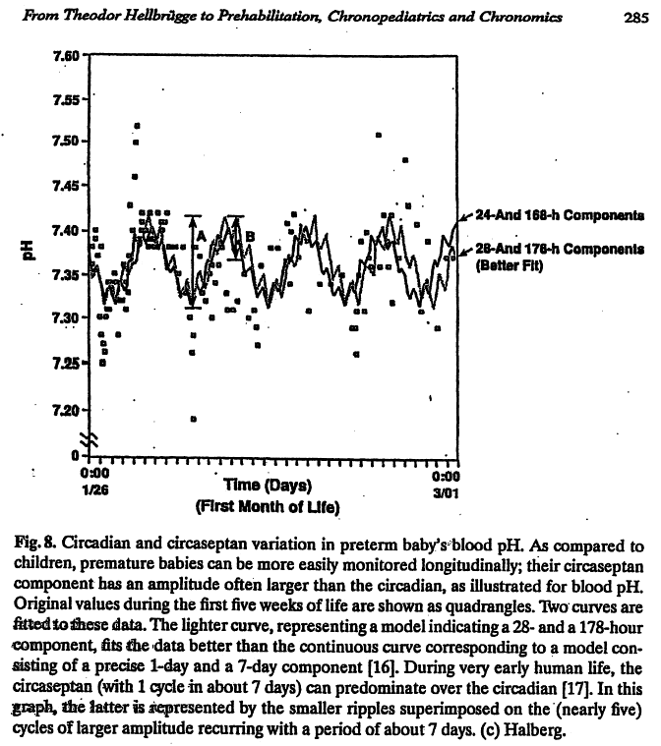

Slide 60
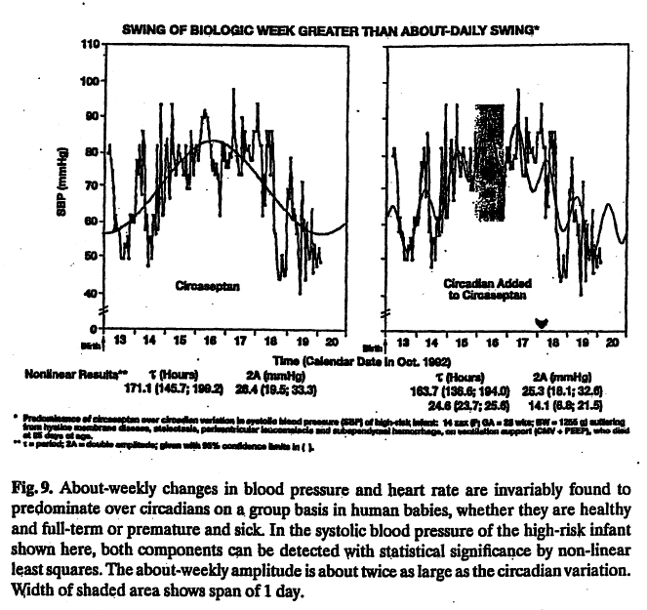

Slide 61
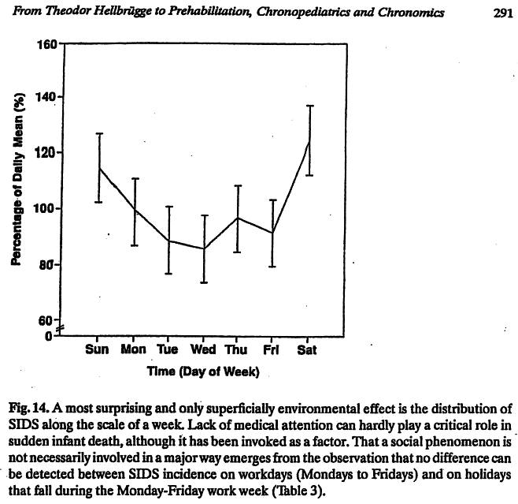

Slide 62
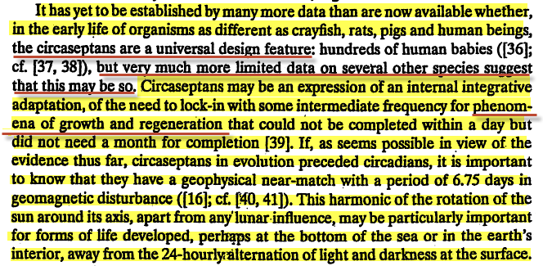

Slide 63
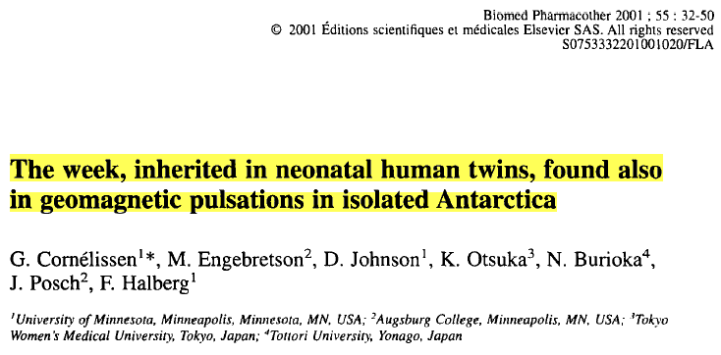
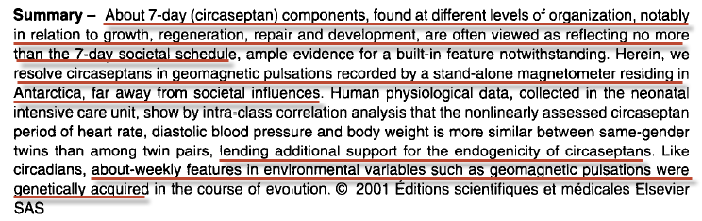

Slide 64
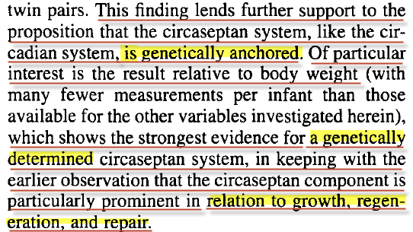
Biomed Pharmacother. 2001: 55. 32-50

Slide 65


Slide 66
Could humans be genetically programmed to a seven day cycle which affects metabolic and brain function?
Might the Seventh Day (Saturday) be part of a circaseptan rhythm when brain physiology is most receptive to “Downloads” from The Creator — And the body be in physiologic “Recharging” mode (Restive) in preparation for the work week ahead?

Slide 67
The idea that autism is a static encephalopathy is being challenged by evidence that autism can remit. Some autistic children, for example, get a lot better when they have a fever. They may make eye contact or even talk, which they had not been doing otherwise. (Genetic Explanations Sense and Nonsense; edited by Sheldon Krimsky & Jeremy Gruber, Harvard University Press, 2013, p.129.)

Slide 68
And it shall come to pass, that from one new moon to another, and from one sabbath to another, shall all flesh come to worship before me, said the LORD.
(Isaiah 66:23 AKJV)

Slide 69
For whoever shall keep the whole law, and yet offend in one point, he is guilty of all.
(James 2:10 AKJV)
Whoever breaks one commandment is guilty of breaking them all.
(James 2:10 GNB)

Slide 72
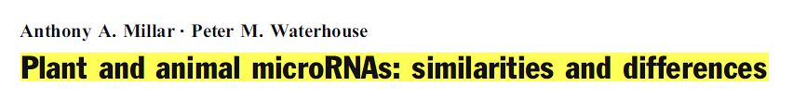
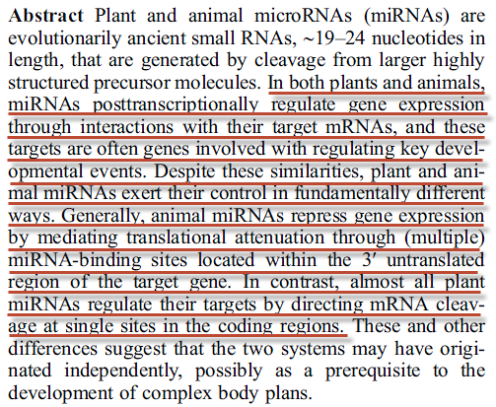
Funct Integr Genomics (2005) 5: 129–135

